Slide 1
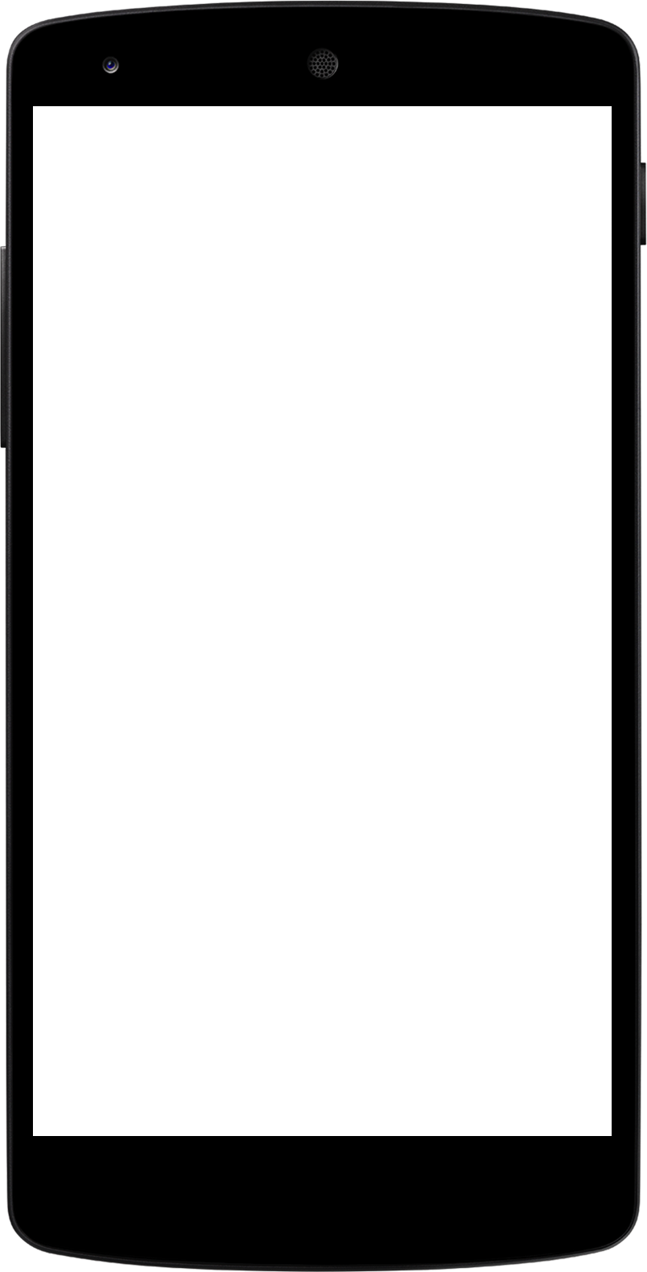

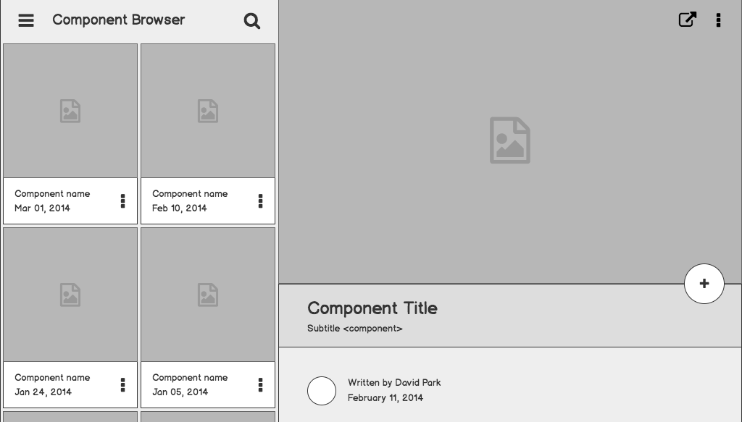
Project Chatform
An innovative hci concept of filling lengthy forms.

Slide 2
Group Members
Arifullah Jan
Waqas Yaseen
Yahya Tahir

Slide 3
The Problem

Slide 4
Problem statement
Ever had to fill a lengthy form such as cykiq’s signup form.
Bad at first impression.
May cause not even going forward. You lose users.

Slide 5
Justify your effort to try to solve the problem.
Highlight the pain points of the current solution or how customers deal with not having a solution to the problem.

Slide 6

It is quick and easy at first impression.
01
1
The user is not shown the whole lengthy form in the first place.

Slide 7

Users like it.
02
It’s just so interesting… Users get super engaged.

Slide 8

Input type aware!
03
It has the ability to adapt to the type of the input e.g. string, email, date, etc..

Slide 9
It’s chat ui

Slide 10

Component Detail (Mobile)

Slide 11
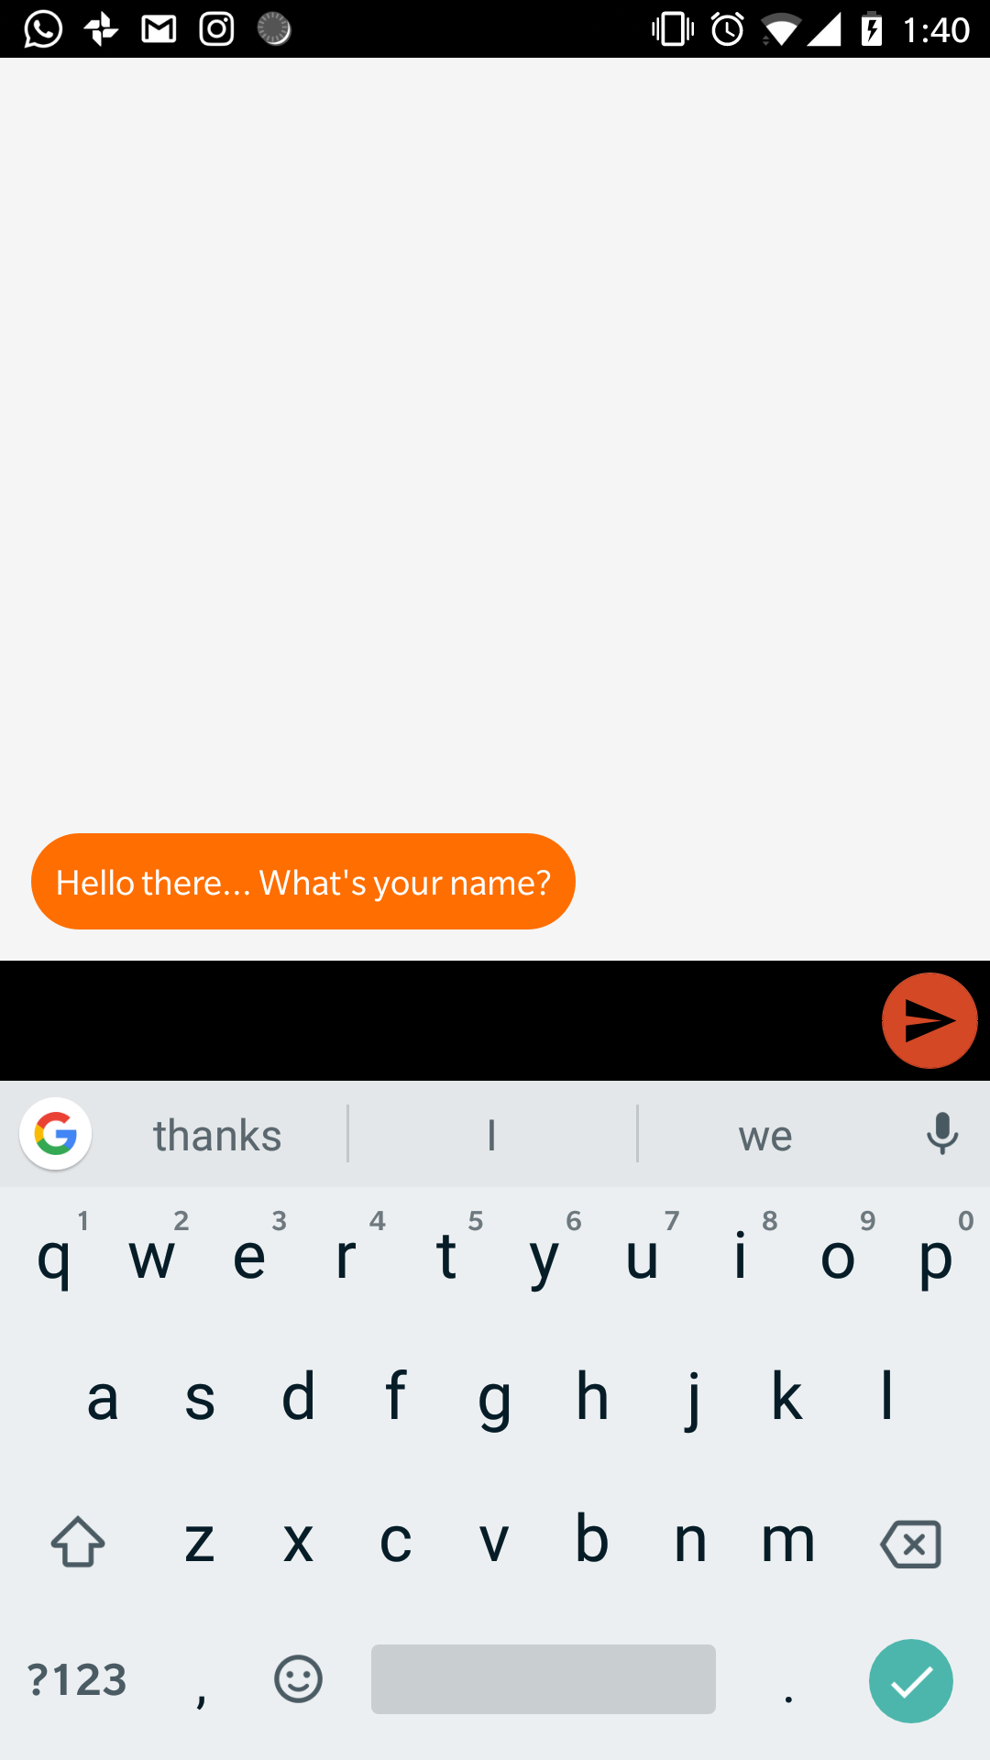
Component Detail (Mobile)
Interactive

Slide 12
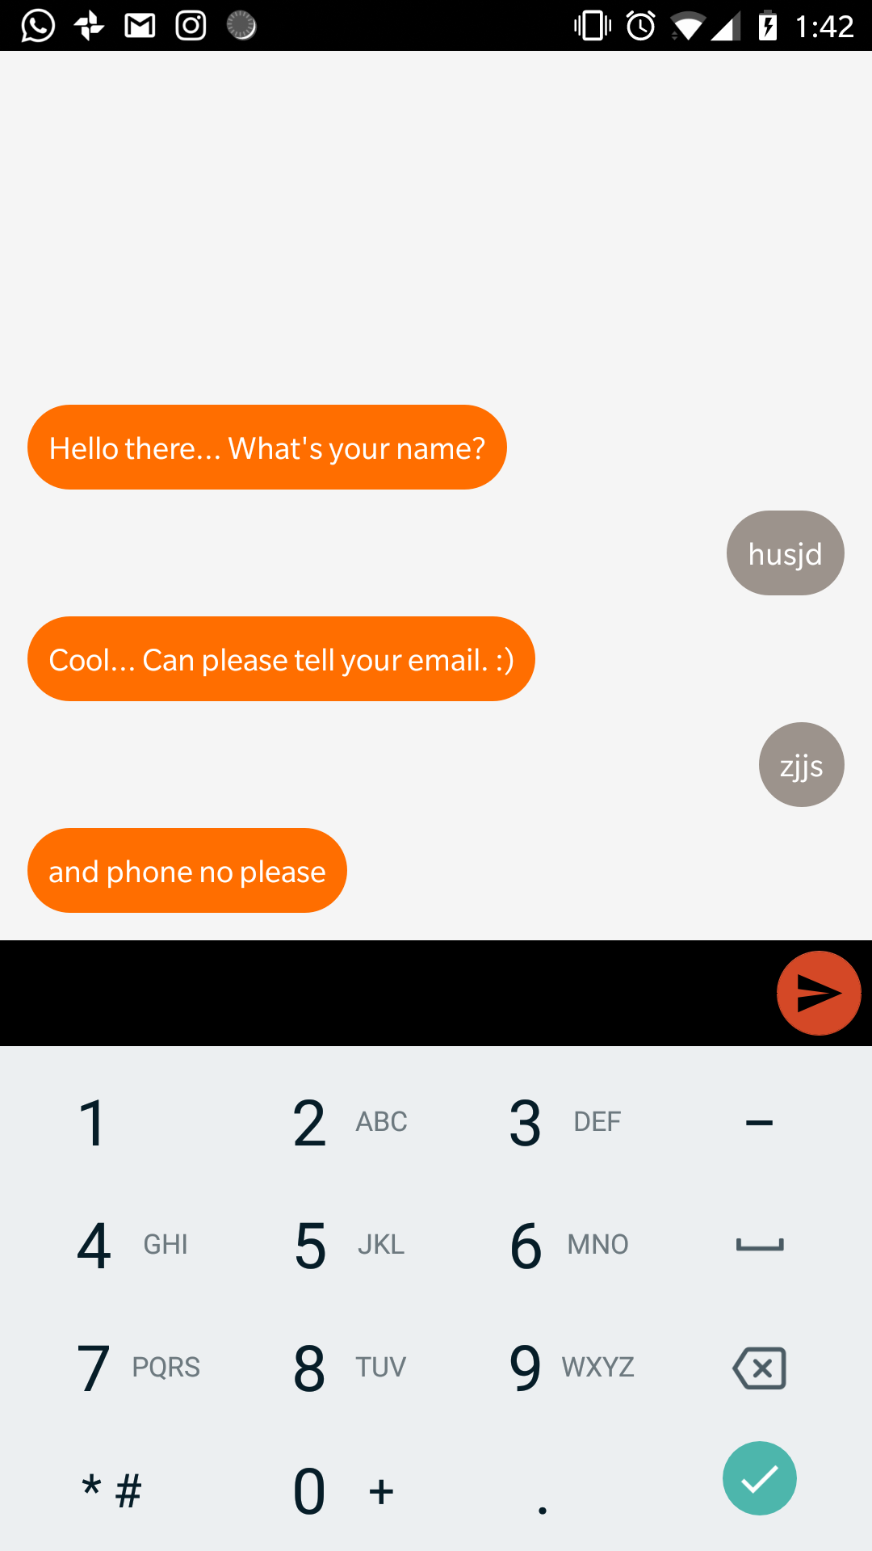
Component Detail (Mobile)
Responsive to the type of input.

Slide 13
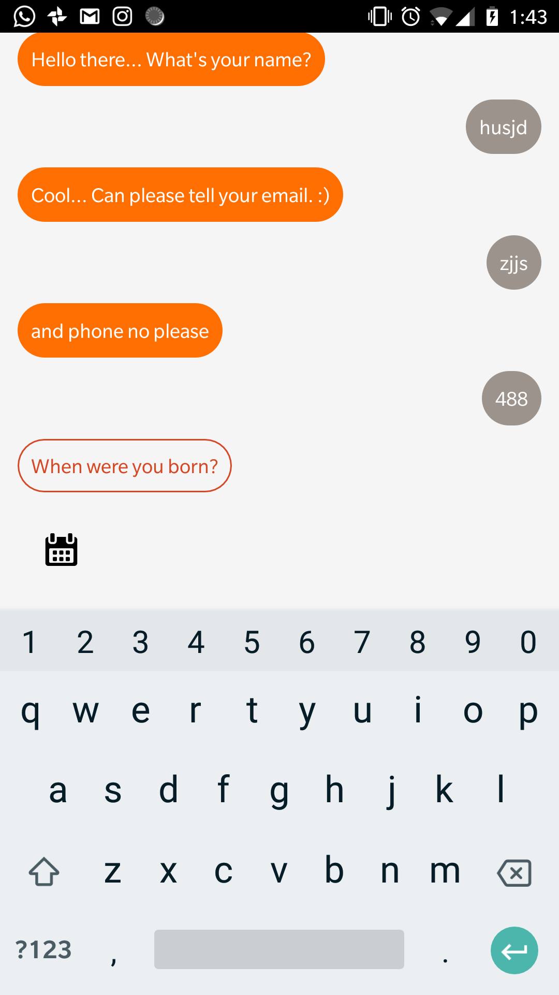
Component Detail (Mobile)
Button to open the chooser

Slide 14
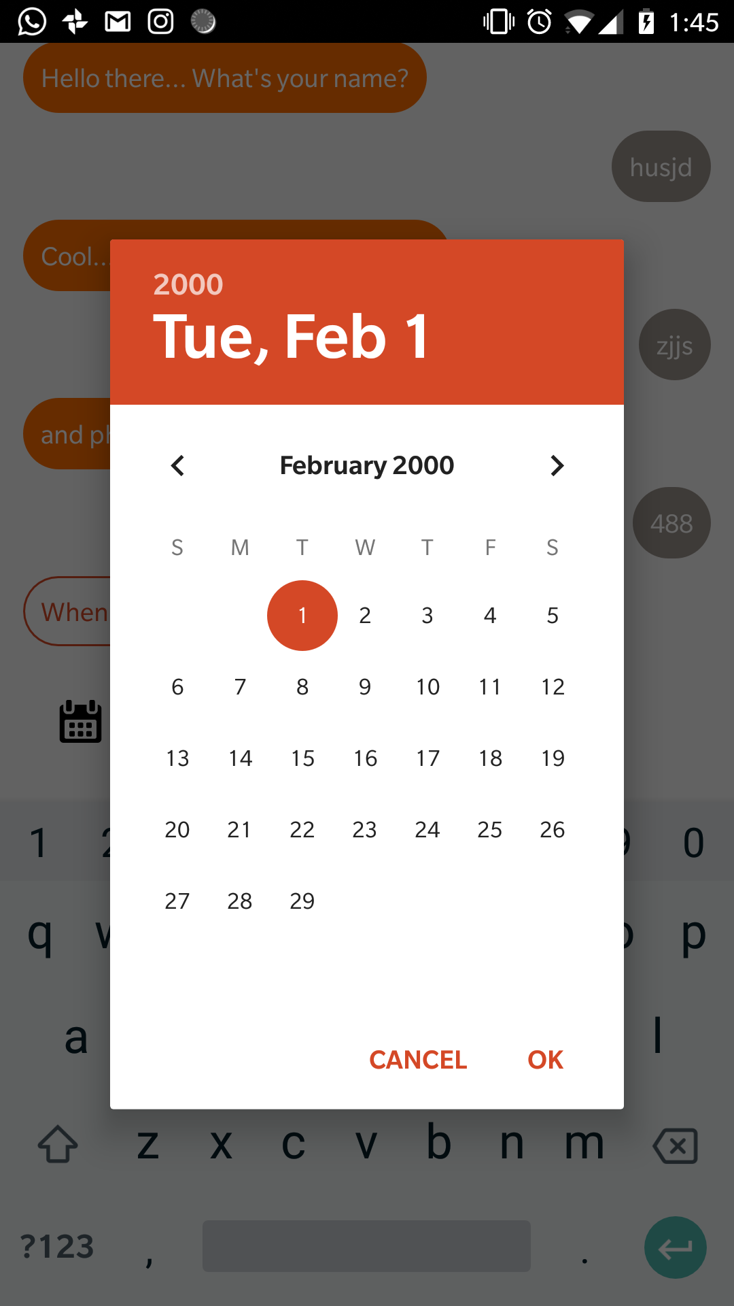
Component Detail (Mobile)
Easy to interact with chooser dialog.

Slide 15


Our Goal
Chatform Library
Open Source library so that anyone can use it in their app.
A survey app like Google forms.
ChatForm apps and webapps

Slide 16
Use cases / user stories
Use cases, user stories, notes to set up the wireframes. Such as…
“As an Administrator, I would like to restrict permissions based on role.”
“As a Moderator, I would like to flag and approve comments.”
Executives indicated that being able to see a summary of each segment of data was their #1 priority.
Note: secondary admin workflow not planned for this release.

Slide 17
Solution description
Now that you’ve justified your attention to the problem, summarize your solution in one or two sentences.

Slide 18
Why it’s better than existing solutions
Return to the problem now that you’ve introduced your solution. Compare your solution to others and describe how it is superior.

Slide 19
Wireframes

Slide 20
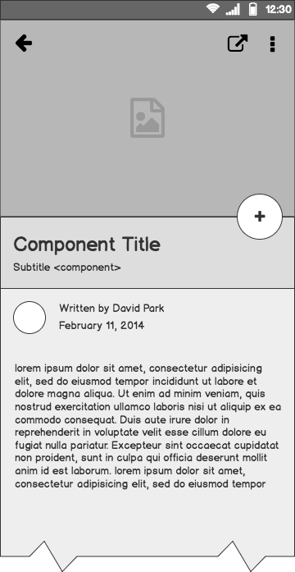
Component Detail (Mobile)
Articulate your design decisions by adding justifications

Slide 21
Timeline
MAY
JUN
TODAY
AUG
SEPT
OCT
NOV
Requirements gathering
User research
Wireframes
Review
Prototype
User testing
Dev hand-off

Slide 22
Questions?

Slide 23
References
Tips for Presenting Your Wireframes
3 Steps to Better UI Wireframes
Wireframing for Beginners

